Slide 1
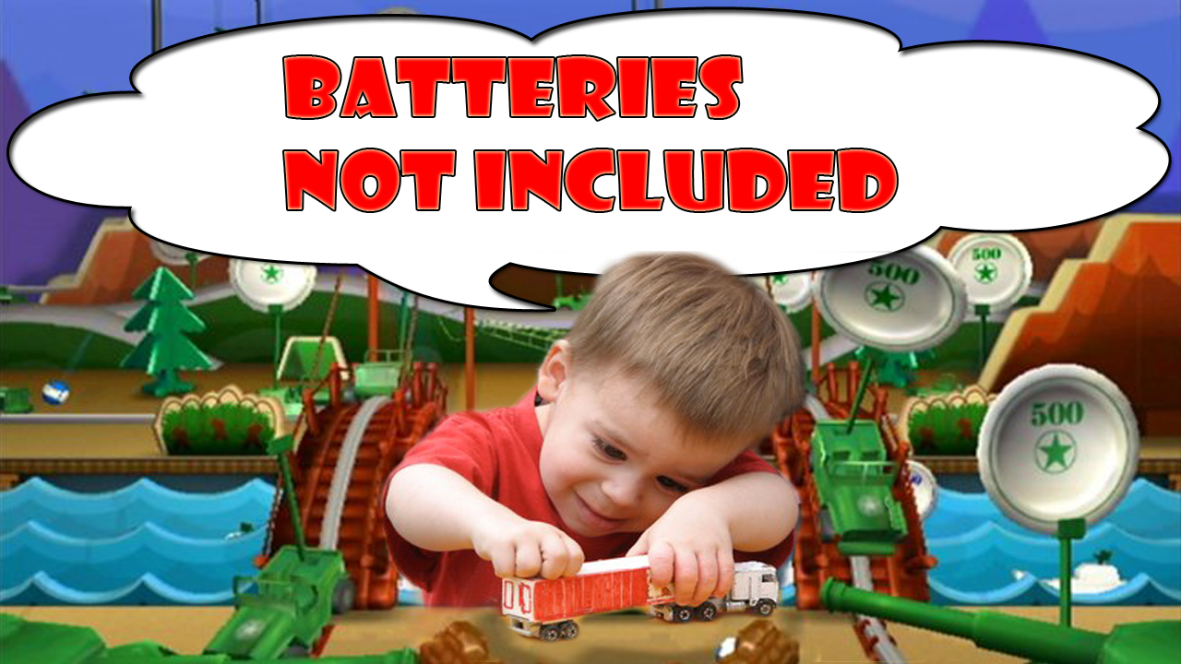
Batteries Not Included
By Neal’s Group

Slide 2

Mission Statement
“Unlike many other tower defense titles, you start the attack in our game. You beat back the enemies and then hold them back with your towers until you make your next push. Then once their units are depleted you go deeper into hostile territory with branching war paths so each play-through is different.”

Slide 3

Game Features
Fully 3D
Simple controls
Slick UI
Unique mechanics
Variety of units and towers
Replay value

Slide 4
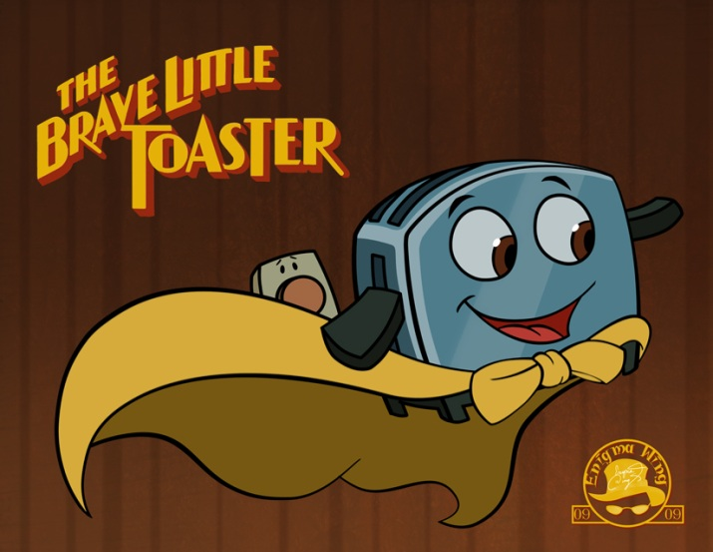
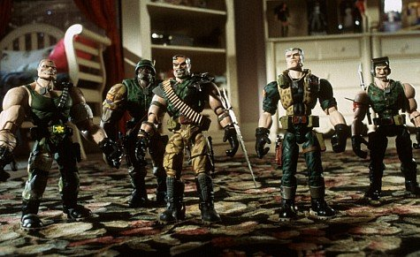
Art Direction/Creativity
Pixar
DreamWorks
Disney
Toys
Cartoons

Slide 5


Goals
Portfolio
Indie3
Full Indie
CVGA
E3

Slide 6
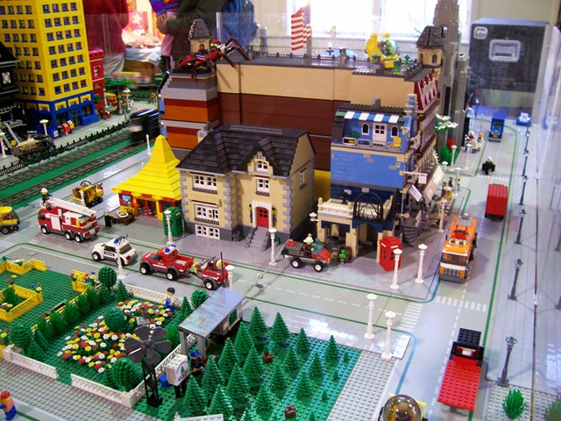
Questions

